Slide 1
NICKEL-CADMIUM AND Li-ion BATTERY

Slide 2
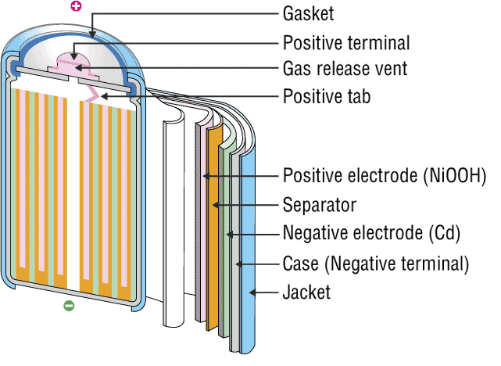
INTRODUCTION
The nickel–cadmium battery is a type of rechargeable battery using nickel oxide hydroxide and metallic cadmium as electrodes. Ni-Cd batteries are made in a wide range of sizes and capacities.
Nickel(hydroxide)–cadmium systems are the most common small rechargeable battery type for portable appliances. The sealed cells are equipped with “jelly roll” electrodes, which allow high current to be delivered in an efficient way. These batteries are capable of delivering exceptionally high currents, can be rapidly recharged hundreds of times, and are tolerant of abuse such as over discharging or overcharging.
It produces a voltage of about 1.4 V

Slide 3
INVENTIONS AND SCOPE
Nickel-cadmium (NiCd)
Invented by Waldemar Jungner in 1899. Developments were slow, but in 1932, advancements were made to deposit the active materials inside a porous nickel-plated electrode. Further improvements occurred in 1947 by absorbing the gases generated during charge, which led to the modern sealed NiCd battery.
For many years, NiCd was the preferred battery choice for two-way radios, emergency medical equipment, professional video cameras and power tools. In the late 1980s, the ultra-high capacity NiCd rocked the world with capacities that were up to 60 percent higher than the standard NiCd.
Since the disposal of battery is hazardous to environment alternative cells are being used such as paper battery

Slide 4
RECENT TRENDS
The primary trade-off with Ni–Cd batteries is their higher cost and the use of cadmium. This heavy metal is an environmental hazard, and is highly toxic to all higher forms of batteries.
Recently, nickel–metal hydride and lithium-ionbatteries have become commercially available and cheaper, the former type now rivaling Ni–Cd batteries in cost..
The batteries are more difficult to damage than other batteries, tolerating deep discharge for long periods.
Ni–Cd batteries typically last longer, in terms of number of charge/discharge cycles, than other rechargeable batteries such as lead/acid batteries.
Compared to lead–acid batteries, Ni–Cd batteries have a much higher energy density.
In consumer applications, Ni–Cd batteries compete directly with alkaline batteries. A Ni–Cd cell has a lower capacity than that of an equivalent alkaline cell, and costs more.
The capacity of a Ni–Cd battery is not significantly affected by very high discharge currents.

Slide 5
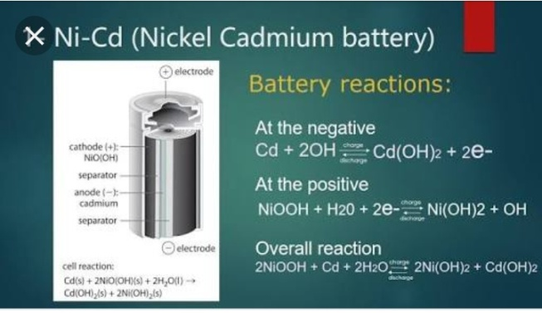
CELL REPRESENTATION AND CELL REACTION
A typical Ni-Cd battery is represented as
Cd| Cd(OH)2|| NiO(OH)| Ni(OH)2
Cell reaction while discharging
At Anode: oxidation of Cd metal
Cd + 2OH_ Cd(OH)₂ + 2e⁻
At cathode: reduction of NiO(OH)
2NiO(OH) + 2H₂O + 2e⁻ 2Ni(OH)₂ + 2OH⁻
Net Cell reaction:
2NiO(OH) + 2H₂O + Cd 2Ni(OH)₂ + Cd(OH)₂

Slide 6
ADVANTAGES
Fast and simple charging process
It is compact and lighter than traditional batteries
It has a longer life than lead storage batteries
Available in a wide range of sizes and performance options
Good low-temperature performance
Only battery that can be ultra-fast charged with little stress

Slide 7
LIMITATIONS
It is rather more expensive than a lead storage battery
It has a lower energy density value
Cadmium is a toxic metal. Cannot be disposed of in landfills
Memory effect; needs periodic full discharges
High self-discharge; needs recharging after storage

Slide 8


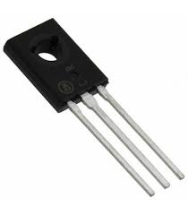

APPLICATIONS
Ni-Cd cells are popularly used in many appliances because they are available in variety of sizes and capaciities.
Few examples are:
Calculators
Electronic flash units
Transistors
Cordless appliances

Slide 9
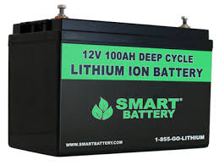
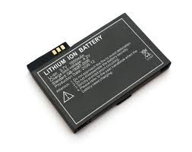
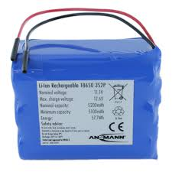
Li-ion Battery DESCRIPTION
A lithium-ion battery or Li-ion battery (abbreviated as LIB) is a type of rechargeable battery in which lithium ions move from the negative electrode to the positive electrode during discharge and back when charging.
The electrolyte, which allows for ionic movement, and the two electrodes are the constituent components of a lithium-ion battery cell.

Slide 10

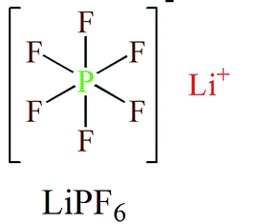
Electrolytes
Role-
Ion conduction between cathode and anode.
They are generally, Lithium salts dissolved in organic solvent.
Commercial electrolytes: in Carbonate solvent.

Slide 11
Anode Materials
Requirements:
Large capabilites of adsorption.
High efficency of charge/discharge.
Low reactivity against electrolyte.
Fast reaction rate.
Low cost
Environment friendly
Commercial anode materials:
Hard Carbon, Graphite

Slide 12
Cathode Materials
Requirements:
A high discharge voltage
A high energy capacity
A high power density
Light weight
Low self discharge
Environment friendly
Commercial cathode materials:
LiCoO2, LiFePO4 etc.

Slide 13
Chemical Reactions
Main essential components...
Anode: Graphite [carbon] - C(s)
Cathode: Lithium Cobalt Oxide - LiCoO2
Electrolyte: Typically a combination of lithium salts - LiPF6, LiBF4, or LiClO4, in an organic solvent, such as either.
Separator: The separator is a very thin sheet of micro perforated plastic. - CH2=CHCl

Slide 14
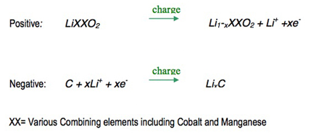
Reactions while charging
On charge the positive electrode, cathode, material is oxidized, Li+ ions are de-intercalated from the layered lithium LiCoO2, pass across the electrolyte and are intercalated between the graphite layers in graphite by an electrochemical reduction reaction proceeding at the negative electrode.

Slide 15
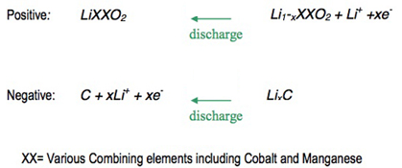
Reactions while discharging
When the cell is discharged, an oxidation reaction occurs at the negative electrode, Li+ ions are de-intercalated from the anode and migrate across the electrolyte to be re-intercalated into the cathode material, due to charge balance the equivalent number of electrons travel through the external circuit. A simultaneous electrochemical reduction reaction proceeds at the positive electrode and accepts electrons from the external circuit, Li+ ions from the electrolyte, to reform the starting material. A change from electronic current to ionic current occurs at the electrode/electrolyte interface.

Slide 16
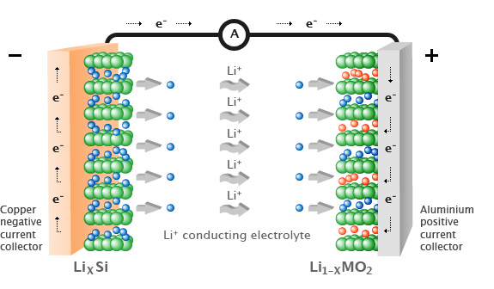
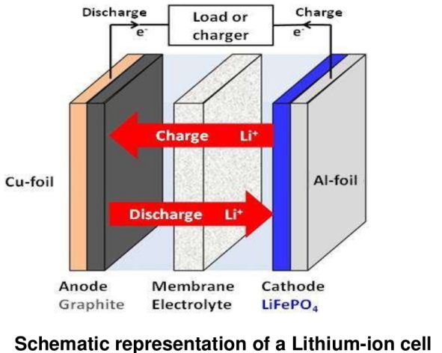


Slide 17
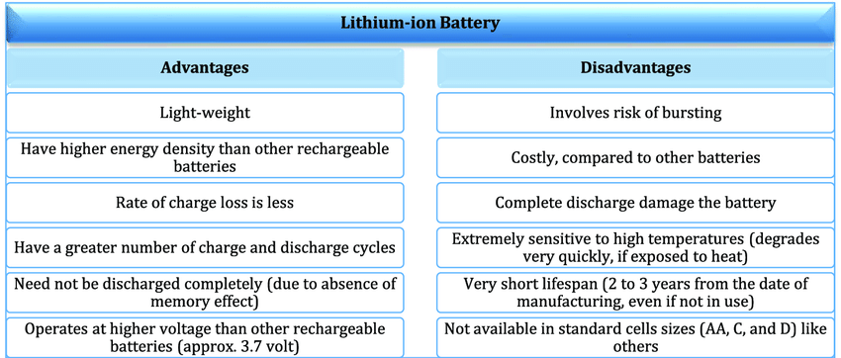

Slide 18
Applications
Emergency Power Backup Or UPS
Dependable Electric And Recreational Vehicle Power
Solar Power Storage
Reliable And Lightweight Marine Performance
Solar Power Storage
Surveillance Or Alarm Systems In Remote Locations
Personal Freedom With Mobility Equipment
Portable Power Packs That Eliminate Downtime

Slide 19
